Slide 1


PYTHON
Lecture 30

Slide 2

Today’s Agenda
Tuple-I
What Is A Tuple ?
Differences With List
Benefits Of Tuple
Creating Tuple
Packing / Unpacking A Tuple
Accessing A Tuple

Slide 3
What Is A Tuple ?
Python provides another type that is an ordered collection of objects.
This type is called a tuple.

Slide 4
Differences With List
Tuples are identical to lists in all respects, except for the following properties:
Tuples are defined by enclosing the elements in parentheses (()) instead of square brackets ([]).
Tuples are immutable.

Slide 5
Advantages Of Tuple Over List
Program execution is faster when manipulating a tuple than it is for the equivalent list.
They prevent accidental modification.
There is another Python data type called a dictionary, which requires as one of it’s components a value that is of an immutable type. A tuple can be used for this purpose, whereas a list can’t be.

Slide 6
How To Create A Tuple ?
As mentioned before a tuple is created by placing all the items (elements) inside a parenthesis ( ), separated by commas.
It can contain heterogeneous elements also.
# empty tuple
my_tuple = ()
# tuple having integers
my_tuple = (1, 2, 3)
# tuple with mixed datatypes
my_tuple = (1, "Hello", 3.4)

Slide 7

Guess The Output ?
my_tuple = (2)
print(my_tuple)
print(type(my_tuple))
Output:
Why did it happen ?
Since parentheses are also
used to define operator
precedence in expressions ,
so , Python evaluates
the expression (2) as simply
the integer 2 and
creates an int object.

Slide 8

So , How To Create A 1 Element Tuple ?
To tell Python that we really want to define a singleton tuple, include a trailing comma (,) just before the closing parenthesis.
my_tuple = (2,)
print(my_tuple)
print(type(my_tuple))
Output:

Slide 9

Guess The Output ?
my_tuple = ()
print(my_tuple)
print(type(my_tuple))
Output:

Slide 10
Packing And Unpacking A Tuple
Packing and unpacking is another thing which sets tuples apart from lists.
Packing:
Packing is a simple syntax which lets us create tuples "on the fly" without using the normal notation:
a = 1, 2, 3
This creates a tuple of 3 values and assigned it to a. Comparing this to the "normal" way:
a = (1, 2, 3)

Slide 11
Packing And Unpacking A Tuple
Unpacking:
We can also go the other way, and unpack the values from a tuple into separate variables:
a = 1, 2, 3
x, y, z = a
After running this code, we have x = 1, y = 2 and z = 3.
The value of the tuple a is unpacked into the 3 variables x, y and z.
Note that the number of variables has to exactly match the number of elements in the tuple, or there will be an exception.

Slide 12
Uses Of Packing And Unpacking
In the previous code , the variable a is just used as a temporary store for the tuple.
We also can leave the middle-man and do this:
x, y, z = 1, 2, 3
After running this code, as before, we have x = 1, y =2 and z = 3.
But can you guess what Python is doing internally ?

Slide 13



Internal Working
First the values are packed into a tuple:
Next, the tuple is assigned to the left hand side of the = sign:
Finally, the tuple is unpacked into the variables:

Slide 14
Swapping Of 2 Variables
We have seen the following code many times before which swaps the variables a and b :
a = 10
b = 20
b, a = a, b
Now , can you tell what is happening internally ?
First, a and b get packed into a tuple.
Then the tuple gets unpacked again, but this time into variables b then a.
So the values get swapped!

Slide 15

Returning Multiple Values From Function
Here Python will do the following:
It will pack the values of c and d in a tuple
Then it will unpack this tuple into the variables x and y
In the second call since z is a single variable , it is automatically converted into a tuple
def calculate(a,b):
c=a+b
d=a-b
return c,d
x,y=calculate(5,3)
print("Sum is",x,"and difference is",y)
z=calculate(15,23)
print("Sum is",z[0],"and difference is",z[1])
Output:

Slide 16
Guess The Output ?
def add(a,b,c,d):
print("Sum is",a+b+c+d)
mytuple=(10,20,30,40)
add(mytuple)
Output:
Why did it happen ?
Since we are passing mytuple as a
single argument , so Python
is giving exception.
What is the solution ?
To overcome this we must
unpack mytuple to 4 individual
values. This can be done by
prefixing mytuple with
a *. So the call will be
add(*mytuple)

Slide 17

Solution
def add(a,b,c,d):
print("Sum is",a+b+c+d)
mytuple=(10,20,30,40)
add(*mytuple)
Output:

Slide 18
Accessing The Tuple
Similar to a list , we can access/print a tuple in three ways:
Directly passing it to the print( ) function
Accessing individual elements using subscript operator [ ]
Accessing multiple elements using slice operator [ : ]

Slide 19

Printing The Entire Tuple
values=(10,20,30,40)
print(values)
Output:

Slide 20
Accessing Individual Elements
Like a list , a tuple also has indexes running from 0 to size-1
For example:
mynums=(10,20,30,40,50)
The above code will create a logical diagram in memory, where positive indexing will go from 0 to 4 and negative indexing from -1 to -5

Slide 21
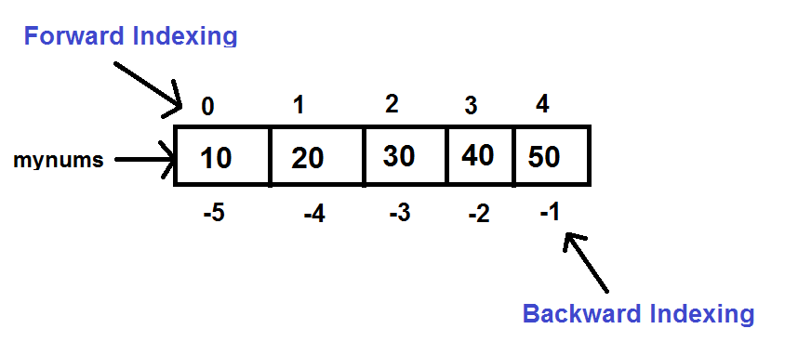
Accessing Individual Elements

Slide 22

Accessing Individual Elements
mynums=(10,20,30,40,50)
print(mynums[0])
print(mynums[1])
print(mynums[-3])
print(mynums[-2])
Output:
Even though we create tuple using the symbol of ( ) but when we access it’s individual element , we still use the subscript or index operator [ ]

Slide 23

Accessing Tuple Elements Using While Loop
mynums=(10,20,30,40,50)
n=len(mynums)
i=0
while i<n:
print(mynums[i])
i=i+1
Output:
Just like len( ) works with list, similarly it also works with tuple and returns number of elements in the tuple

Slide 24
Accessing Tuple Elements Using For Loop
mynums=(10,20,30,40,50)
for x in mynums:
print(x)
Output:
Since tuple is a sequence type , so for loop can iterate over individual elements of the tuple

Slide 25
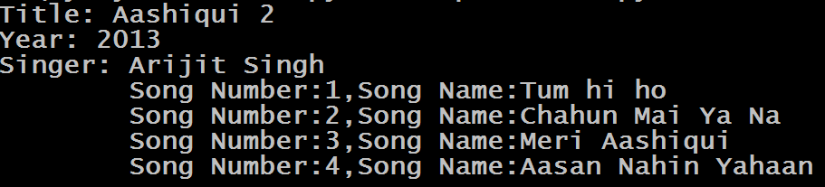
Exercise
Given the tuple below that represents the Arijit Singh’s
Aashiqui 2 songs.
Write code to print the album details, followed by a listing of
all the tracks in the album.
album="Aashiqui 2", 2013 ,"Arijit Singh",((1,"Tum hi ho"),(2,"Chahun Mai Ya Na"),(3,"Meri Aashiqui"),(4,"Aasan Nahin Yahaan"))
Output:

Slide 26
Solution
album="Aashiqui 2","Arijit Singh",2013,((1,"Tum hi ho"),(2,"Chahun Mai Ya Na"),(3,"Meri Aashiqui"),(4,"Aasan Nahin Yahaan"))
title,singer,year,songs=album
print("Title:",title)
print("Year:",year)
print("Singer:",singer)
for info in songs:
print("\tSong Number:{0},Song Name:{1}".format(info[0],info[1]))

Slide 27
Slice Operator With Tuple
Just like we can apply slice operator with lists and strings , similarly Python allows us to apply slice operator with tuple also.
Syntax: tuple_var[x:y]
x denotes the start index of slicing and y denotes the end index . But Python ends slicing at y-1 index.

Slide 28
The Slicing Operator
Example:
mynums=(10,20,30, 40,50)
print(mynums[3:5])
Output:
(40,50)
Example:
mynums=(10,20,30,40,50)
print(mynums[1:4])
Output:
(20,30,40)

Slide 29
The Slicing Operator
Example:
mynums=(10,20,30, 40,50)
print(mynums[0:10])
Output:
(10,20,3040,50)
Example:
mynums=(10,20,30,40,50)
print(mynums[0:4])
Output:
(10,20,30,40)

Slide 30
The Slicing Operator
Example:
mynums=(10,20,30, 40,50)
print(mynums[6:10])
Output:
( )
Example:
mynums=(10,20,30,40,50)
print(mynums[2:2])
Output:
( )

Slide 31
The Slicing Operator
Example:
mynums=(10,20,30, 40,50)
print(mynums[:3])
Output:
(10,20,30)
Example:
mynums=(10,20,30,40,50)
print(mynums[1: ])
Output:
(20,30,40,50 )

Slide 32
The Slicing Operator
Example:
mynums=(10,20,30, 40,50)
print(mynums[-2:])
Output:
(40,50)
Example:
Mynums=(10,20,30,40,50)
print(mynums[ :-2])
Output:
(10, 20,30 )

Slide 33
Using Step Value
The concept of step value in slicing with tuple is also same as that with list
Movement is in forward direction ( L→R)
Default for start is 0 and end is len
But if step is negative , then
Movement is in backward direction (R→L)
Default for start is -1 and end is –(len+1)

Slide 34
The Slicing Operator
Example:
mynums=(10,20,30, 40,50)
print(mynums[1:4:0])
Output:
ValueError: Slice step cannot be 0
Example:
mynums=(10,20,30,40,50)
print(mynums[1:4:2])
Output:
(20,40)

Slide 35
The Slicing Operator
Example:
mynums=(10,20,30, 40,50)
print(mynums[4:1:-1])
Output:
(50,40,30)
Example:
mynums=(10,20,30,40,50)
print(mynums[4:1:1])
Output:
( )

Slide 36
The Slicing Operator
Example:
Mynums=(10,20,30, 40,50)
print(mynums[::-1])
Output:
(50,40,30,20,10)
Example:
mynums=(10,20,30,40,50)
print(mynums[::])
Output:
(10,20,30,40,50 )

